Slide 1
Final Project Evaluation
SentiHinglish
Sentiment Analysis for Hinglish Code-mixed tweets by means of Cross-lingual Word Embeddings
Group Id- 20
Soham Rahul Inamdar, 210100149, Electrical Engineering
Mayank Gupta, 210101002, Electrical Engineering
Anuj Gupta, 21d070014, Electrical Engineering
Archit Gupta, 210100021, Electrical Engineering
Date: 27/11/2024

Slide 2
Problem Statement
Description: The objective of the project is to perform Sentiment Analysis on Hinglish tweets. This is essentially a classification problem. We need a reliable method to convert text to vector/tensor embeddings which can be given as input to any classifier. We study various embedding methods and the performance achieved on the classification task.
Input: A tweet written in “Hinglish”
Output: Sentiment of the tweet, 0:Negative, 1:Neutral, 2:Positive
Example:
Input: indiatoday sardesairajdeep iska video audio dekhna bewakoof aadmi
Output: 0: Negative

Slide 3
Motivation
Social media is one of the most widespread methods of communication in the 21st century. India, having one of the largest populations in the world contributes to a large number of messages which are often typed in Hinglish(given on the previous slide). Sometimes these texts can carry harmful sentiments which needs to be identified and controlled. Hence, the need for a robust sentiment analysis system serves as the primary motivation for our project.

Slide 4
Literature Review
Sentiment Analysis of Code-Mixed Social Media Text (Hinglish) - https://arxiv.org/pdf/2102.12149/1000
Uses pure statistics to train a classifier
LT3 at SemEval-2020 Task 9: Cross-lingual Embeddings for Sentiment Analysis of Hinglish Social Media Text - https://aclanthology.org/2020.semeval-1.173.pdf
Uses a unified embedding space for cross-lingual
Sentiment Analysis for Hinglish Code-mixed Tweets by means of Cross-lingual Word Embeddings-https://aclanthology.org/2020.calcs-1.6, Singh & Lefever, CALCS 2020

Slide 5
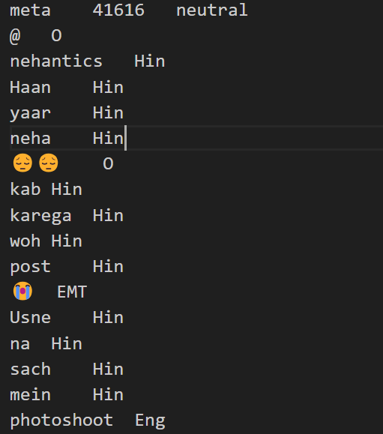
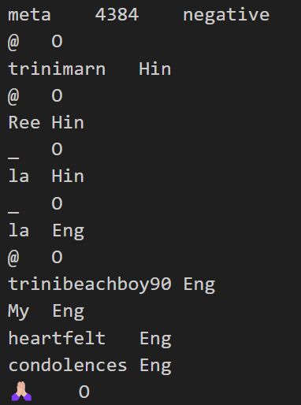
Dataset
We are using the SemEval 2020 dataset for sentiment analysis in code-mixed social media messages.
Data Instance:
Dataset also contains emojis, not just words 😮😮😮

Slide 6
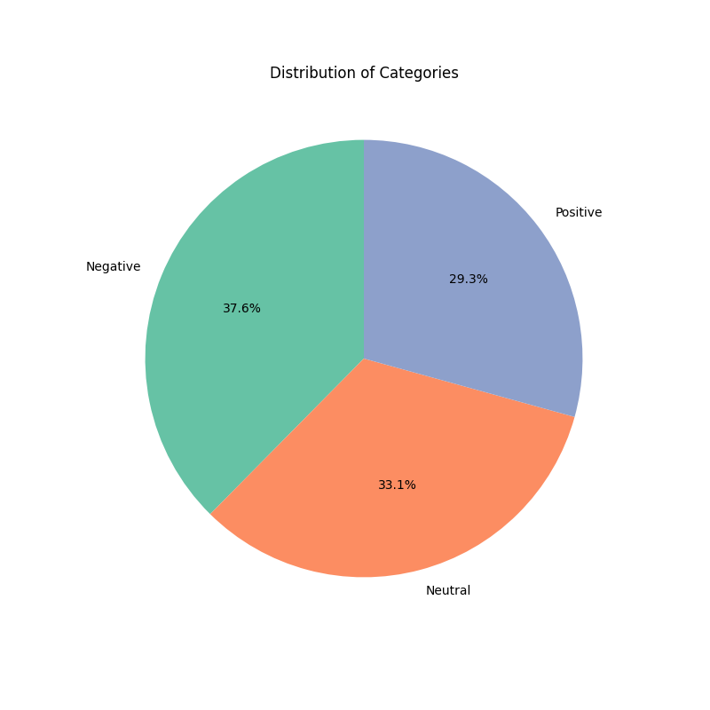
Distribution of Classes
We can observe that the three classes are distributed more or less equally.

Slide 7
Data Preprocessing
Before the data is given to the embedding function, we perform the following steps:
Remove underscores, dots, retweets
Remove links, digits and punctuations
Remove emojis
Make all text lowercase

Slide 8
Method/Technique
The paper uses an LSTM neural network for classification. The details of which are: Size of hidden layers=128, Number of layers=4, Loss=Cross Entropy, Optimizer: SGD (But we have used Adam)
Apart from this we have tried Gated Recurrent Units (GRU) as well
We have tried some methods of embedding:
Baseline: Basic tenserflow vectorizer
VecMap
Glove
BERT: Multilingual BERT (mBERT), XLM RoBERTa

Slide 9
Results
Model/Embedding | Accuracy | F1-Score
LSTM+VecMap | 0.30 | 0.28
LSTM+mBERT | 0.28 | 0.22
LSTM+XLM Roberta | 0.57 | 0.39
LSTM+Glove | 0.62 | 0.59
GRU+Glove | 0.59 | 0.58

Slide 10
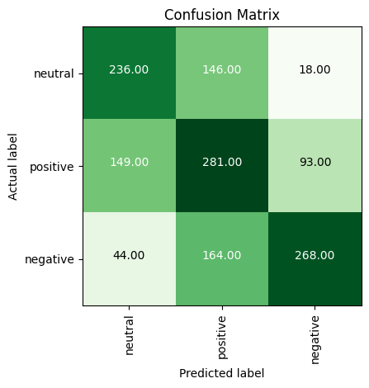

Slide 11
Analysis
Positive is more biased towards and generally over power the errors due to the model being bias towards positive
Negative sentiments due to sarcasm, are more prone to be wrongly labelled.
Neutral sentiments are the most stable against mis labelling

Slide 12
Benchmarking with ChatGPT
Sentence | Our output | ChatGPT output | Reason
kabhi jo badal barse | neutral | positive | GPT uses preference bias, since the input is a song
ek ladki ko dekha toh aisa laga | neutral | positive | GPT uses reference bias, since the input is a song
mujhe khudkhushi karni hai | positive | negative | Due to the word “khushi”
mujhe suicide karni hai | negative | negative | For obvious reasons
mujhe khud ko khush rakhna hai | positive | positive | “Khush” is labelled positive unilaterally

Slide 13
Improvements over the paper
We have tried using Glove embeddings to convert text to vectors which is giving is slightly better results.
We have used Adam Optimizer with weight decay=5e-4, which leads to faster convergence as compared to SGD used by the paper.

Slide 14
Learnings
We learned the importance of good data preprocessing. This was not something which we had given much importance to in the assignments.
We also learned how to extend the models made for primarily English data to Hinglish data. This could prove vital since a large amount of ML/NLP research is carried out in English.

